Slide 1
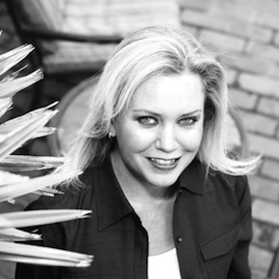
Food Nation Radio with Elizabeth Dougherty “This is NOT your typical food show”
* Food news and information about the foods they eat and take home to their families.
* Interviews with award-winning chefs, restaurant owners, and food safety experts
* Listeners are shown how easy it is to cook fresh, organic, healthy foods.
* Elizabeth Dougherty is a writer, trained chef, and an award-winning talk show host.
* Tips and secrets about dining out * In a twist, listeners hear what servers have to say about customers.
Food Nation Radio was on the forefront of presenting expert guests with vital information about GMOs, at a time when no one was talking about or even knew about the subject.
RECENT GUESTS ON AWARD-WINNING FOOD NATION RADIO
* Bill Marler: Food safety attorney on why CEOs of food production companies are very concerned right now!
* Jacques Pepin: TV Food Pioneer on his new cookbook. * Dr. Don Huber: Professor Emeritus from Purdue University who made the connection between intestinal diseases and GMOs.
* Rep. Michelle Vasilinda-Rehwinkle: Introduced the first bill to label GMOs in Florida.
* Russ Benblatt: Whole Foods Market discussed the plan to require labeling in their stores.
* Jaydee Hanson: Center for Food Safety on why the pubic should beware of genetically modified salmon.
* Dr. Stephanie Seneff: While researching the alarming rise in Autism found a connection to foods.
* Dr. Kurt Azevedo: A former Monsanto employee who was alarmed by testing procedures and spoke out. * Jeffrey Smith: Producer of Genetic Roulette and the world’s leading expert on genetically modifications.
Food Nation Radio with Elizabeth Dougherty “takes listeners on a one-of-a-kind, fun, thought-provoking look at American cuisine and what’s in our food supply and they love it!”
ADVERTISING ON FOOD NATION RADIO NETWORK Recorded Commercials: :15 / :30 / :60 Live Endorsements: Read LIVE in-show by Elizabeth Dougherty Remote Broadcasts: Live on-site from your business or special event Podcasts: “Pre-roll” commercial placed before each archived podcast Feature Sponsorships: “The Organic Recipe Minute” and more FoodNationRadio.com: Tile/Banner ad placement with logo and links
SHOW INFO & DEMOS Website: FoodNationRadio.com Podcasts: iTunes/iHeart/Google etc. Social Media Reach: 100,000 + Target Age Range: 35 to 60 yrs Audience: 45% Females / 55% Males
FOOD NATION RADIO NETWORK™ WITH ELIZABETH DOUGHERTY LIVE - Saturdays @ 9am (ET) – FoodNationRadio.com
Advertising, Guest Appearances and Broadcast Info: Contact: Michael Serio (407) 255-0166

